Slide 1


Project Presentation
on
Peace : The Mental Stability
Presented by :
Miss. Samreen Bhinder
Mstr. Yash Choudhury
(MCA Second Year Semester III)
Under the Guidance of
Ayesha Mam
Department of Computer Applications
G H Raisoni University, Amravati
Academic Session:2024-25

Slide 2

INDEX
Introduction
Literature Survey
Key Observations
Proposed work:Design/Algorithms
Results & Discussion
Conclusion
Future scope
References (in IEEE format only)

Slide 3

Introduction

Slide 4

Introduction
Mental health therapy is a crucial aspect of maintaining good mental health, yet many individuals face barriers that prevent them from accessing the help they need.
The Mental Stability, will be an journey towards a calmer and more centred you. In today’s fast-paced world, mental well-being is more important than ever. Our app holds a promise to provide a safe, supportive, and non- judgemental space for you to explore your thoughts, emotions, and behaviours and also provides you help to overcome your stress and emotions which are uncontrollable. It is designed to help you navigate life’s challenges with confidence and strength.
Our mission is to empower you with the tools, resources, and support needed to achieve mental stability and peace of mind. Take the first step towards a more peaceful, strong and fulfilling life.

Slide 5
Literature Survey

Slide 6
Literature Survey
Mental therapy, also known as psychotherapy, has undergone significant transformations in recent years. The field has witnessed a shift towards more personalized, technology-driven, and accessible approaches to mental health care. This literature survey explores the latest trends and innovations in mental therapy, highlighting the advancements and challenges in the field. Mental therapy continues to evolve, embracing innovative technologies and approaches to improve outcomes and accessibility. By these innovations, mental therapy can be better support for individuals in achieving optimal mental health and well-being.
Mental health...is not a destination, but a process. It’s about how you drive, not where you’re going. –Noam Shpancer

Slide 7
Here are some government reports on mental therapy from various years:
1. Mental health and well being in India(2022):
- Published by: Indian council of medical research(ICMR)
- Objective:
– A survey by ICMR found that 45.7% of Indians reported feeling stressed, 24.5%
reported anxious and 22.5% reported having high mental health concerns and only
15.6% seeking professional help.
2. India’s Mental Health Report (2020):
- Published by: The Lancet Commission on mental health with ICMR
- Objective:
– 10.6% of Indians suffered from mental health disorders, with higher prevalence of
Woman, young adults and working men. India accounts for 25% of global suicides.
– It suggests a 10-year plan to address mental health challenges and to overcome it.
3. Mental Healthcare Act (2017):
- Published by: Ministry of health and Family Welfare, Government of India
- Objective:
– In 2017, approximately 3.3% of the population in India suffered depression.
– The act allows the rights of person with mental illness includes the right to live in a
community, right of privacy, also provides mental health care and services.

Slide 8
Here are some books on mental health and therapy:
1. Furiously Happy
Author- Jenny Lawson(2015)
Summary- This book explores the experience with mental illness and trauma, and
relationships,with a focus on finding humour,to seek help and support when needed.
2. Daring to Rest
Author- Karen Brody(2017)
Summary- This book explores the importance of rest and self-care for mental health,
and provides practical guidance for prioritizing rest in a busy world.
3. Maybe You Should Talk to Someone
Author- Lori Gottlieb(2019)
Summary- This book explores the experiences of a therapist, and searches into the
difficulty of human relationships and mental health. This book also explains the
human connection and empathy in therapy and maintaining boundaries. It also
explains the role of self-reflection and personal growth in both therapist and patient.

Slide 9
Key Observations

Slide 10
Key Observations
The key observations of the mental therapy applications are:
You can create a profile inside this application and take therapy as needed.
It consists of a space where you can do your journaling, write notes or whatever comes to your mind, and all this will be confidential.
It consists of youtube videos links like meditation, excercises and also some calm and relaxing music for people with anxiety and stress.
It consists a section in which there is a health tracker, which will track the health of person.

Slide 11
Proposed System

Slide 12
Proposed System
Mental Health Theraphy
Guest Login
Sign up/in
Home
Therapy
Explore
Profile
Health Tracker
Journal
Relaxing Music
Meditation

Slide 13
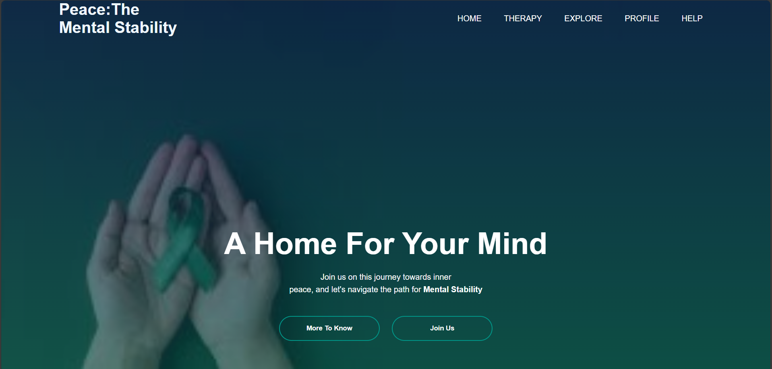
Slide 1-

Slide 14
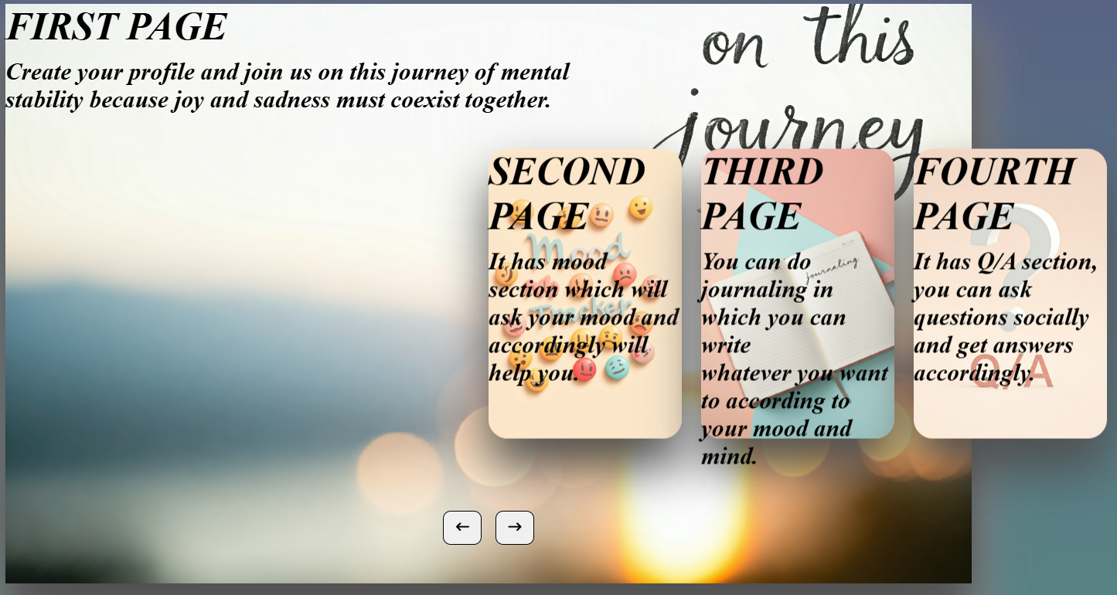
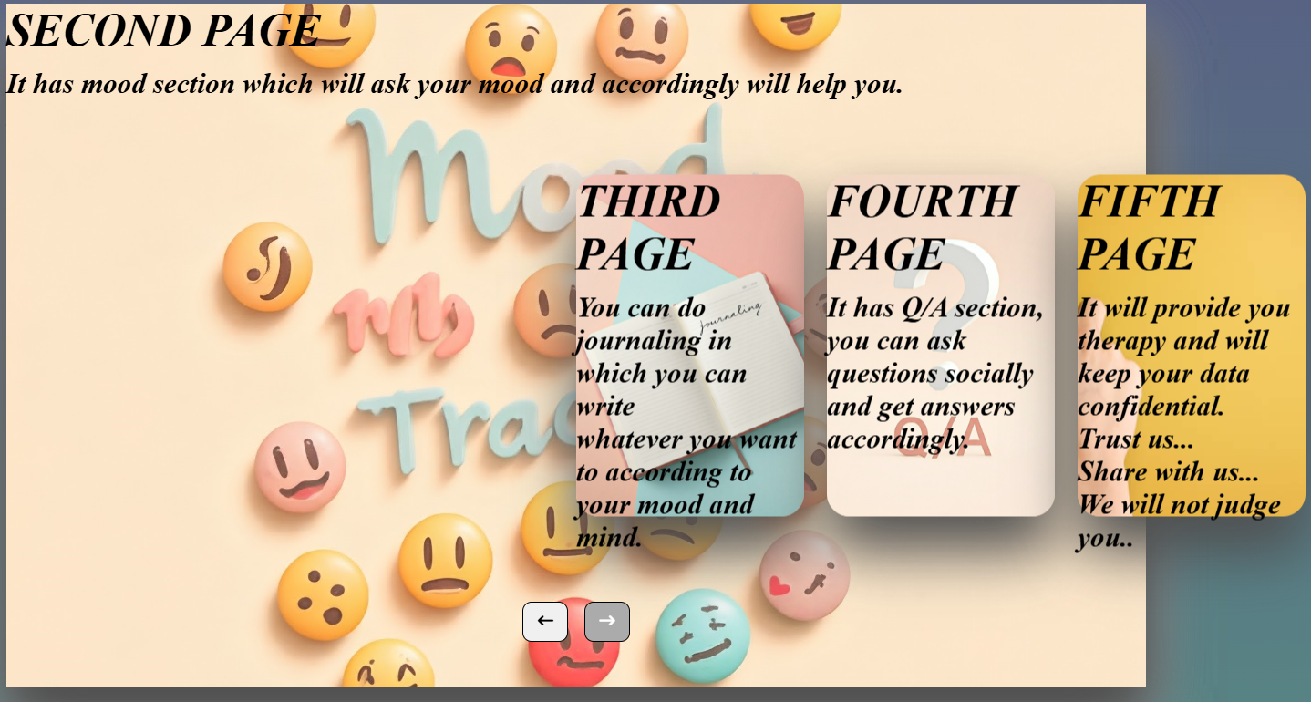
Slides:

Slide 15
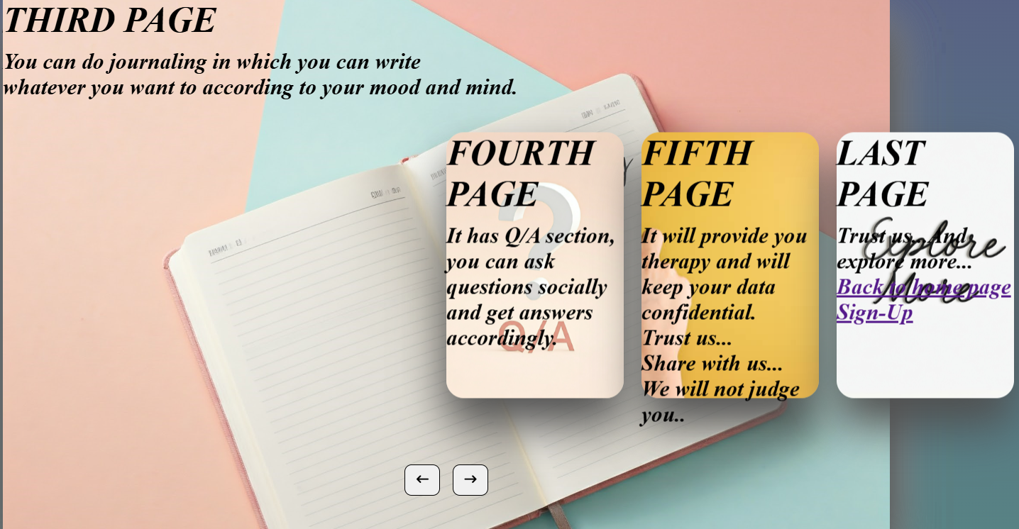
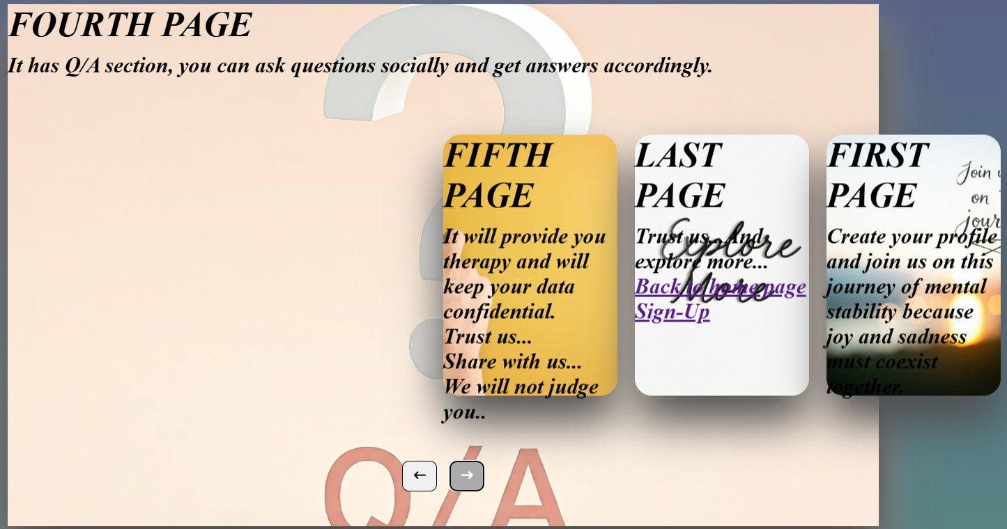
Slides:

Slide 16
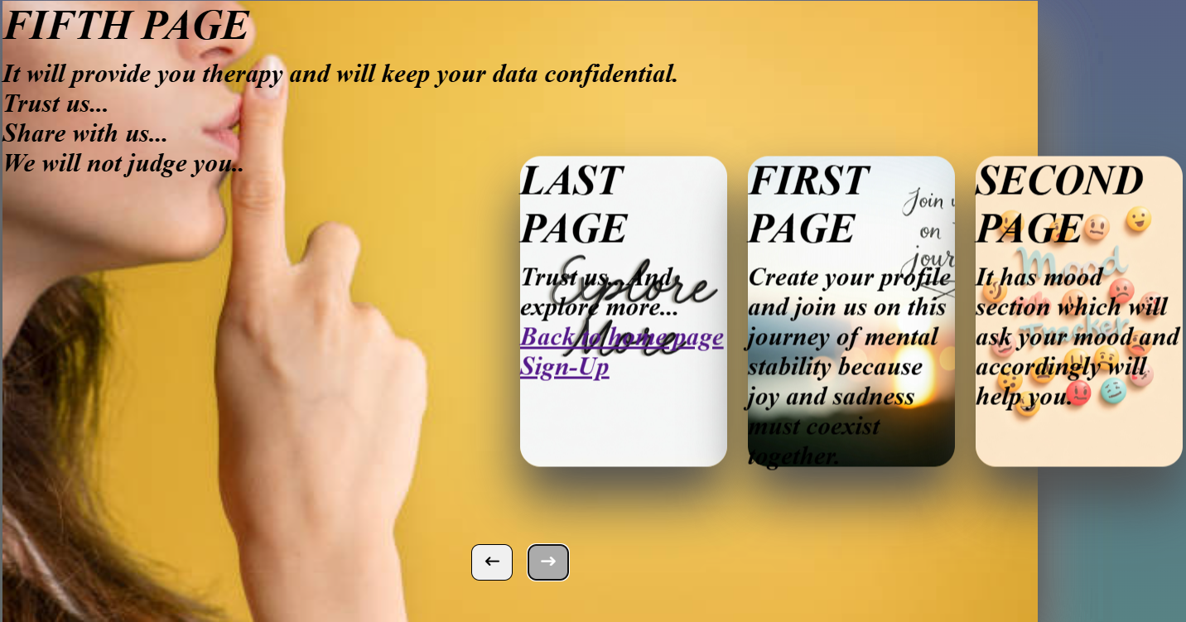
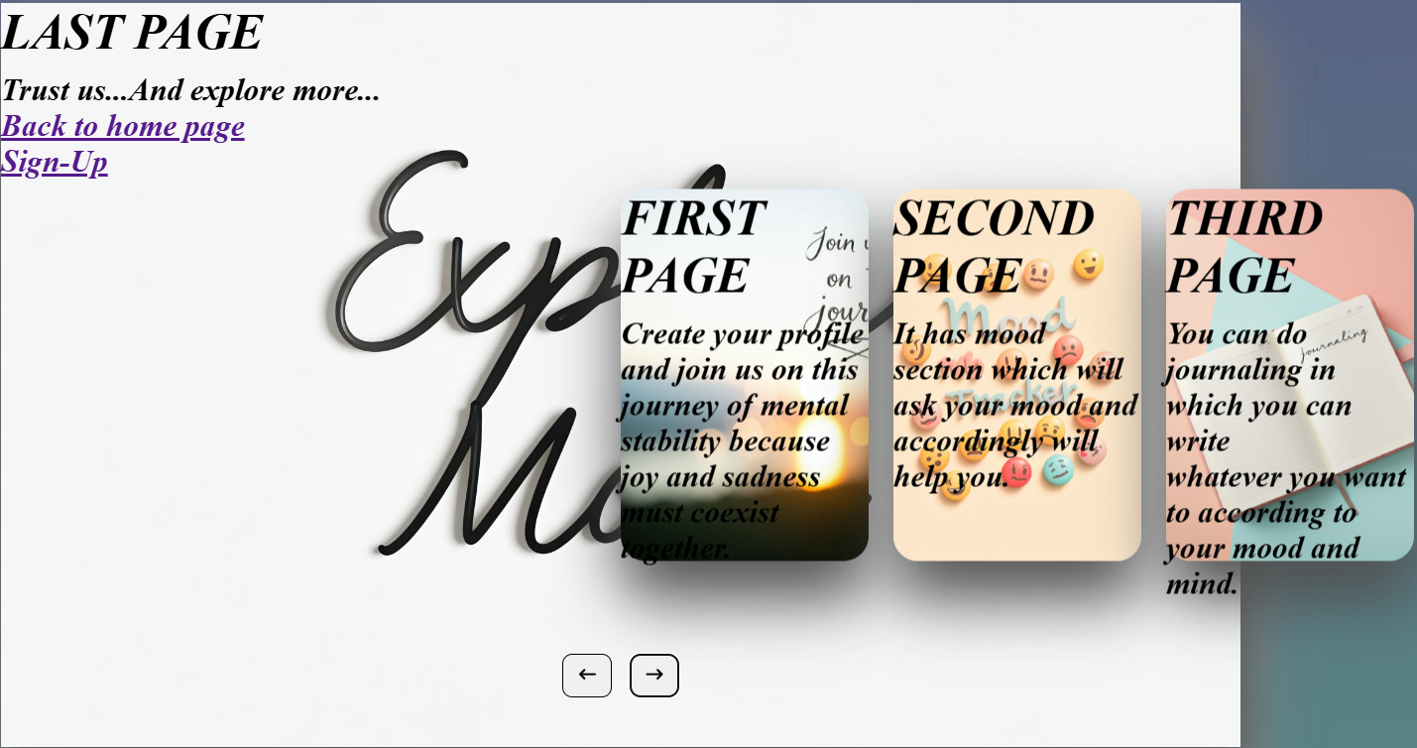
Slides:

Slide 17
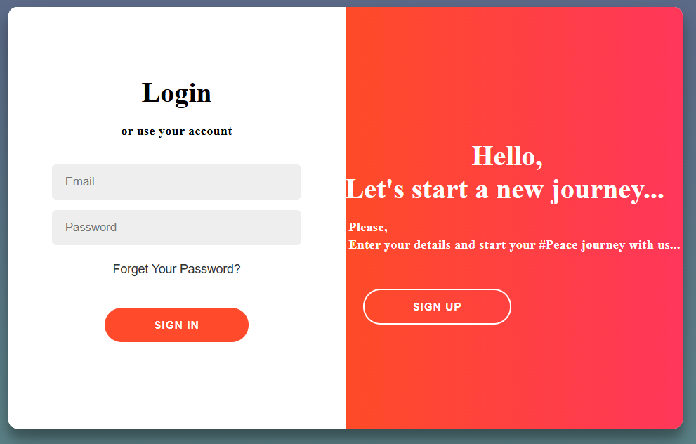
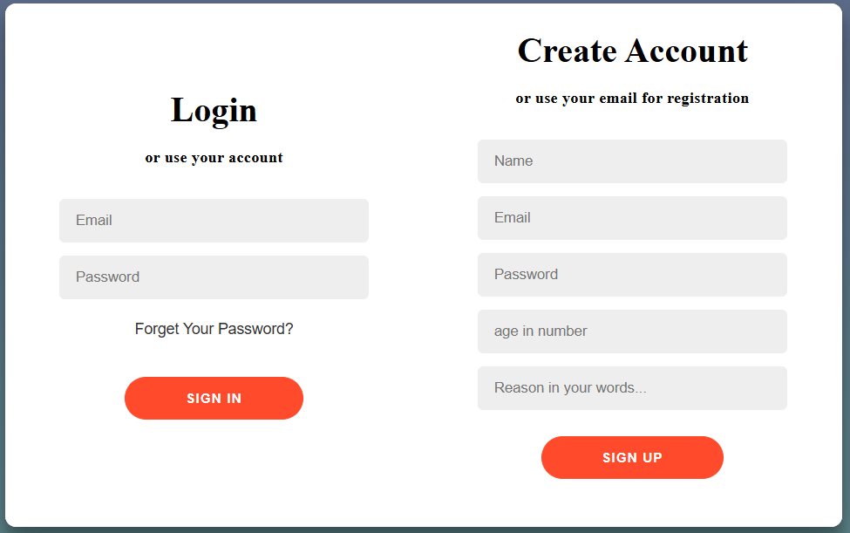
Slides:

Slide 18
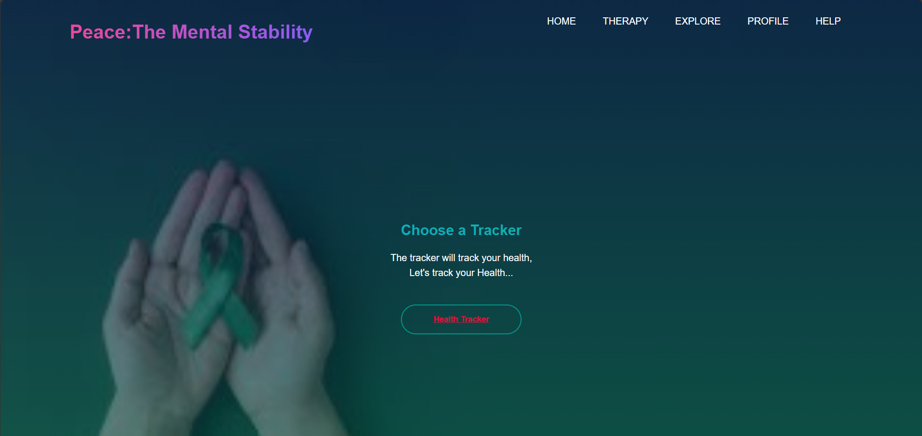
Slides:

Slide 19
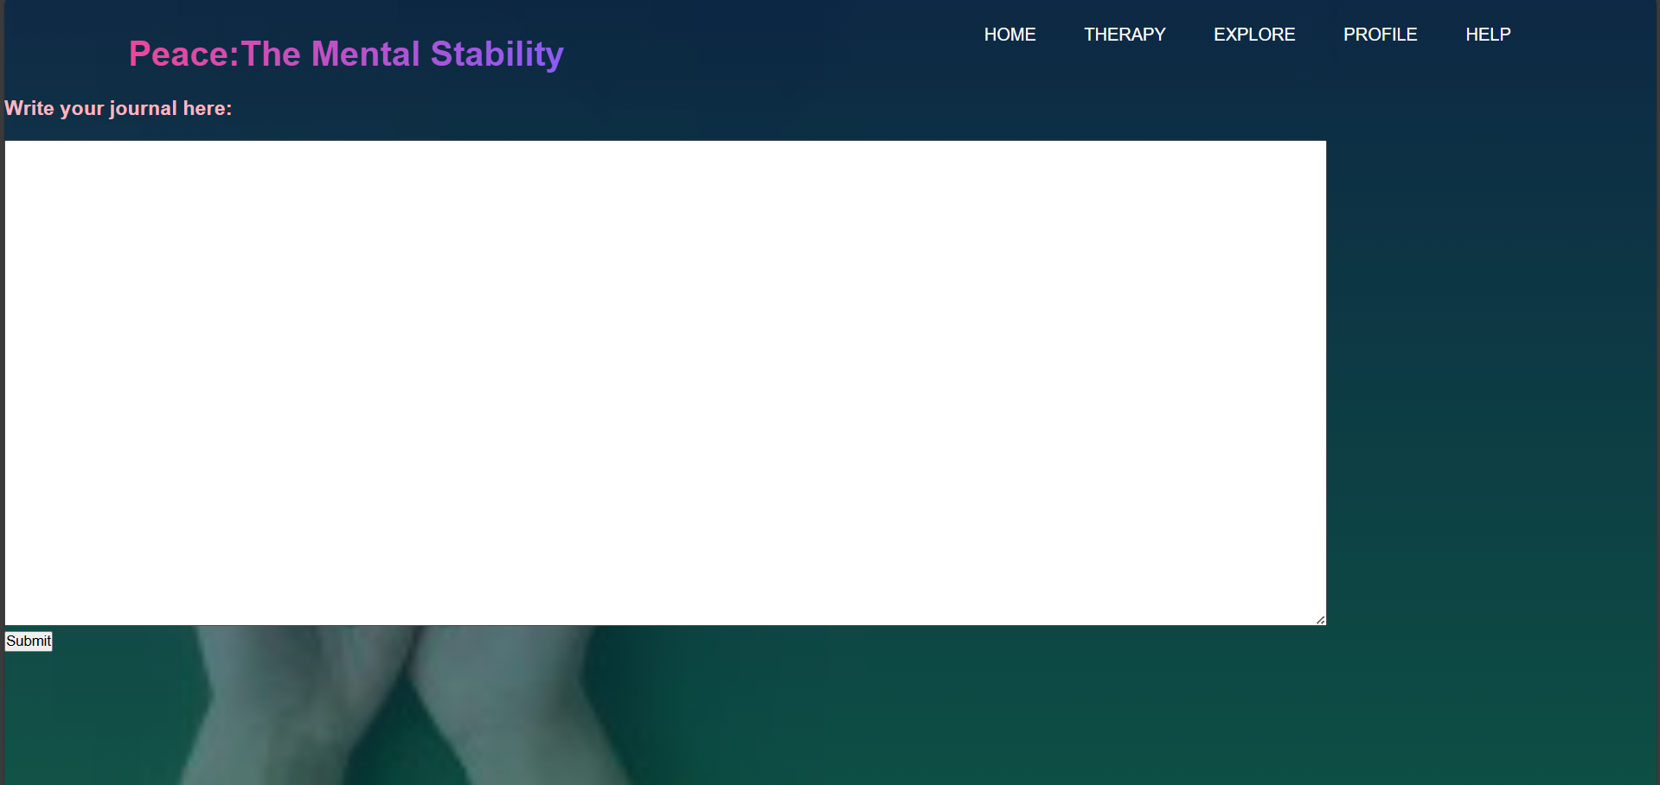
Slides:

Slide 20
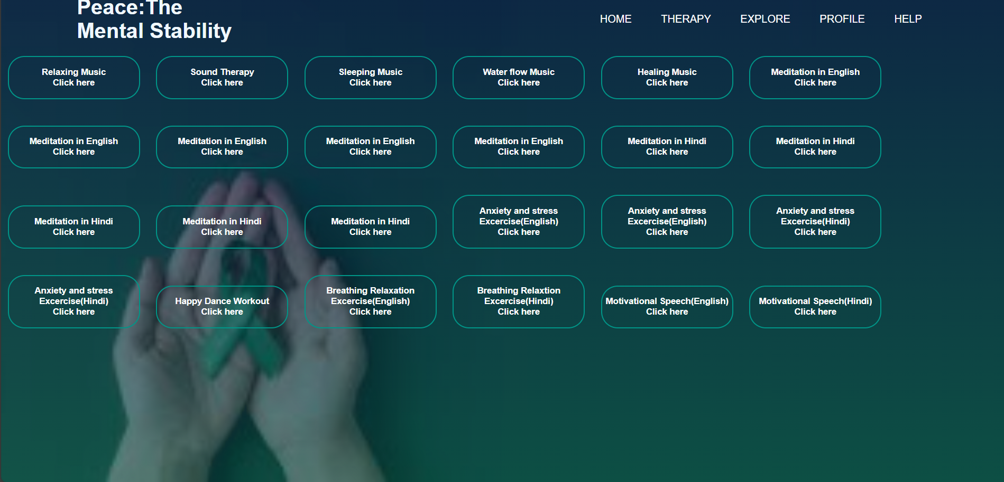
Slides:

Slide 21
Results & Discussion

Slide 22
Results & Discussion
Instictive User Interface: The combination of HTML, and CSS resulted in a clean, modern, and responsive user interface. Users may found this application easy to navigate, with quick access to features according to their needs.
Effective performance: Ascedancing Java’s object-based programming language, which will help in delivering the contents according to the user’s need and convenience.
Efficiency in Data Storage: MySQL provided which will help in giving the application robustness and a scalable solution for storing the user data which will include assesments,mood tracing function. Queries were optimized to ensure quick data retrieval and updates, contributing to the application’s overall liability.

Slide 23
Conclusion

Slide 24
Conclusion
Peace:The Mental Stability is more than just an app, it’s a home for the mind. By providing extensive platform for mental health therapy,we aim to empower individuals to take control of their well-being and finding lasting peace.
Our mission is to make mental health therapy accessible, affordable,and shame free. We believe that everyone deserves peace of mind, and we’re committed to helping them achieve it.
By this app, the user will take the first step towards a more balanced, fulfilling life. Join us on this journey towards inner peace, and let’s navigate the path to mental stability together.

Slide 25
Future scope

Slide 26
Future scope
The future scope of this app is that it can be helpful to the youth who needs therapy but face a lots of barriers like cost, shame of sharing, fear of confidentiality, limited availability,fear of sharing and lot more.This app will help the youth to be confident to share problem and stress with free mind without any fear and to overcome the stress.
The Future scope can be for mental health therapy application-
Expand therapy Content and resources
2. AI-powered chat-bots
3. Social Support Network
4. Providing professional therapists
5. AI-powered mental health diagnosis

Slide 27
References

Slide 28
References
1. HMG ⁄ DH, “No Health without Mental Health: A Cross-Government Mental Health Outcomes Strategy for People of All Ages”. London, 2 February 2011. Gateway reference: 14679.
2. Frederico Cardoso and Zoë McHayle, “The Economic and Social Costs of Mental Ill Health”. March 2024.
3. Martin Knapp, David McDaid and Michael Parsonage (editors), “Mental Health Promotion and Mental Illness Prevention: the Economic Case.” Department of Health,London, April 2011. Gateway reference: 15972.

Slide 29
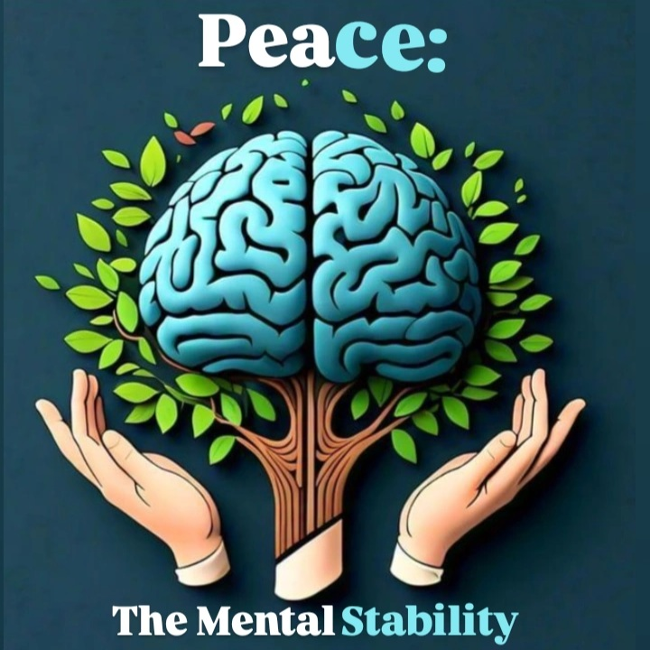

Thank You!

